Slide 1
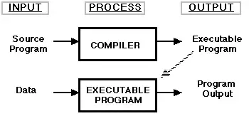
Compiler - Introduction
A Compiler is a computer program that translates computer code written in one programming language into another programming language.
A Compiler takes the entire program and converts it into executable computer code.
It takes an entire program because the computer only understands the program written in 0’s and 1’s and converts the executable program into machine code that is recognized by the computer.
Examples of compiled programming languages are C and C++.
“Compiler” is primarily used for programs that translate source code from a high-level programming language to a lower-level programming language.
A Compiler is likely to perform many or all the operations: preprocessing, lexical analysis, parsing, semantic analysis, conversion of input programs to an intermediate representation, code optimizing and code generation.

Slide 2
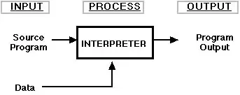
INTERPRETER
What is an Interpreter?
An Interpreter is a computer program, which converts each high-level program statement into machine code.
This include source code, pre-compiled code, and scripts.
An Interpreter is defined as a machine program that directly executes a set of instructions without compiling them.
Examples of interpreted languages are Perl, Python and Matlab.

Slide 3
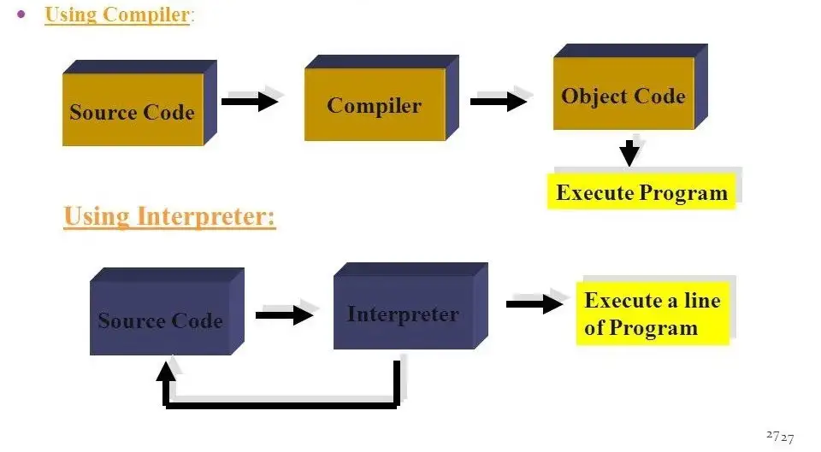
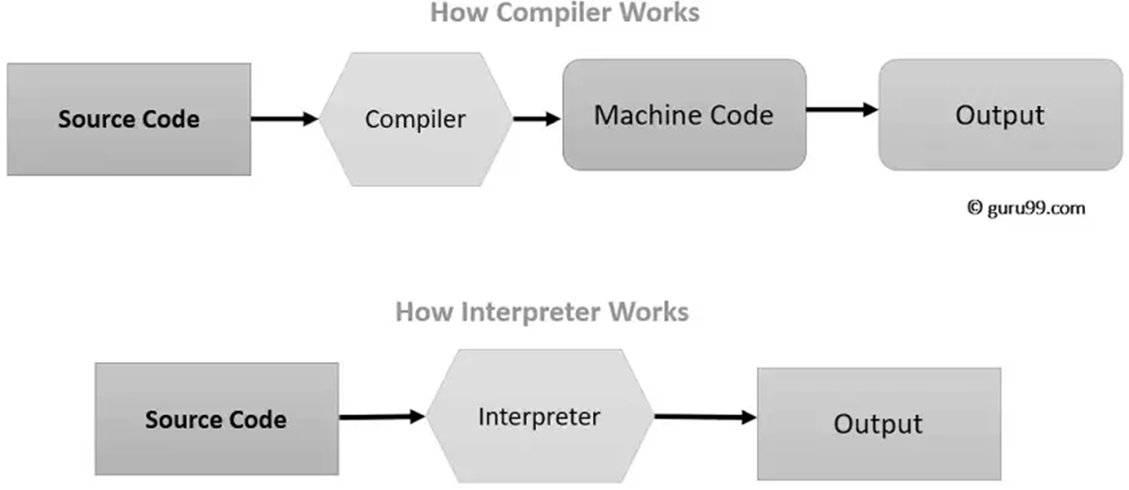

Slide 4
Advantages of Interpreter
Interpreters make working with the source code much easier.
It translates one instruction at a time; therefore it uses a minimum amount of memory.
It is also helpful in the debugging process because the interpreter can relate error messages to the instruction being executed
Disadvantages of Interpreter
Each time the program is executed time is spent interpreting, hence a slower execution time.
Interpreted programs can only run on the computers that have the respective interpreters.
Advantages of Compiler
The program codes are translated into machine code already and hence the time to execute the code is very less.
EXE files execute faster than source codes. The object codes are saved and can run at any time.
Object Codes are harder for a user to change than source codes
The compiler checks the source code for syntax errors during compilation.
Disadvantages of Compiler
As the entire program is translated it uses much more of the computer’s memory.
It is not possible to change the program without going back to the source code while working with a compiler.
Object code needs to be produced before a final executable file, this can be a slow process.
The Source code must be 100% correct for the executable file to be produced.

Slide 5
